Slide 1

KALLAM HARANADHAREDDY INSTITUTE OF TECHNOLOGY (A) DEPARTMENT OF CSE(AI&DS)
MAJOR PROJECT REVIEW – II
DEEP LEARNING TECHNIQUES FOR BREAST CANCER RISK PREDICTION
Project Associates(Batch -05)
1.KUNDETI USHANJALI
Under the Esteemed Guidance Of : 2.PILLI POOJESWAR REDDY
MR. V. MARGASAHA CHARY 3.MAGULURI VENKATA KOTAIAH
(B.Tech , M.Tech , Ph.D) 4.GAMPALA KRISHNA SRI

Slide 2
OBJECTIVE
ABSTRACT
LITERATURE STUDY
DESIGN & ANALYSIS

Slide 3
ABSTRACT
Breast cancer is one of the most common and life-threatening diseases among women globally. Early detection is crucial for effective treatment and improving survival rates.
Various deep learning models, including CNNs and transfer learning, will be employed to identify patterns in the data.
In this project We evaluate the performance of the model using metrics such as accuracy, sensitivity, and specificity
The ultimate goal is to develop a reliable, scalable, and interpretable model that can assist clinicians in early diagnosis and personalized treatment planning, potentially leading to a significant reduction in breast cancer mortality rates.

Slide 4
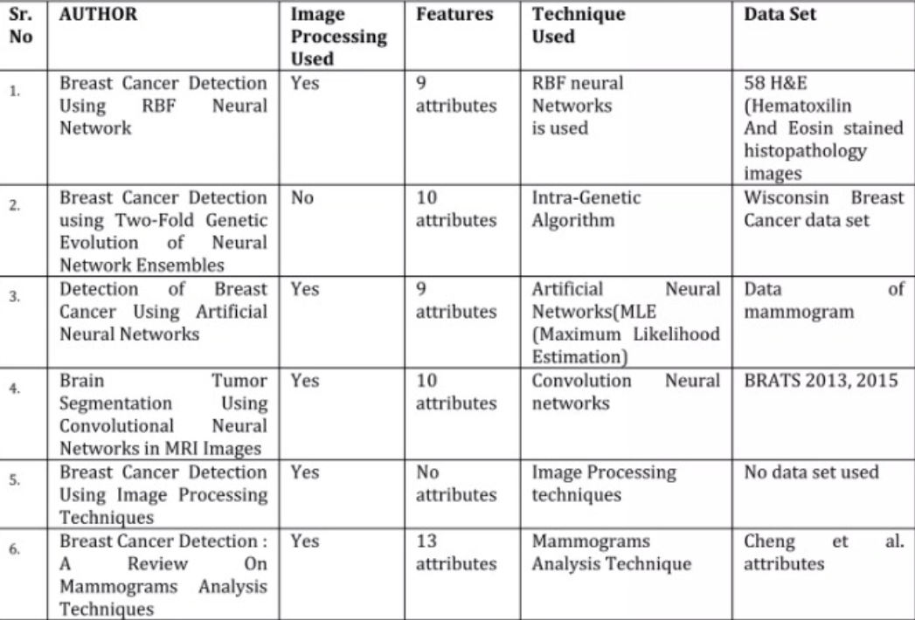
LITERATURE STUDY

Slide 5
DESIGN & ANALYSIS
DATA FLOW & PREPROCESSING
Data Collection: Data sets from Kaggle.
Data Preprocessing: Normalization: Scale pixel values.
Resizing: Uniform image sizes.
Segmentation: Focus on regions of interest.
FEATURE SELECTION
Algorithms Used: CNN: For image classification.
Goal: To develop and evaluate deep learning models that improve the accuracy and
efficiency of breast cancer prediction through medical imaging and data analysis
enhancing early detection and patient outcomes.

Slide 6
DESIGN & ANALYSIS
MODEL SELECTION
Algorithms Evaluated: Neural Networks, CNN .
Final Model Chosen: CNN
MODEL TRAINING AND OPTIMIZATION
Loss Function: Categorical or binary cross-entropy.
Optimizer: Adam or SGD.
Parameters: Choose batch size and epochs based on data.
MODEL EVALUATION METRICS
Performance Measures: Accuracy, Precision, Recall
F1 Score: Key performance indicators.
ROC-AUC Curve: Evaluate across thresholds.

Slide 7
DESIGN & ANALYSIS
ANALYSIS & DEPLOYMENT
Analysis Confusion Matrix: Visualize predictions.
Hyperparameter Tuning: Optimize model performance.
Deployment Model Serving: Use TensorFlow Serving or Flask.
User Interface: Simple UI for clinicians.
RESULT
Result: High accuracy (85%), sensitivity (87%), specificity (82%), AUC (0.90).

Slide 8
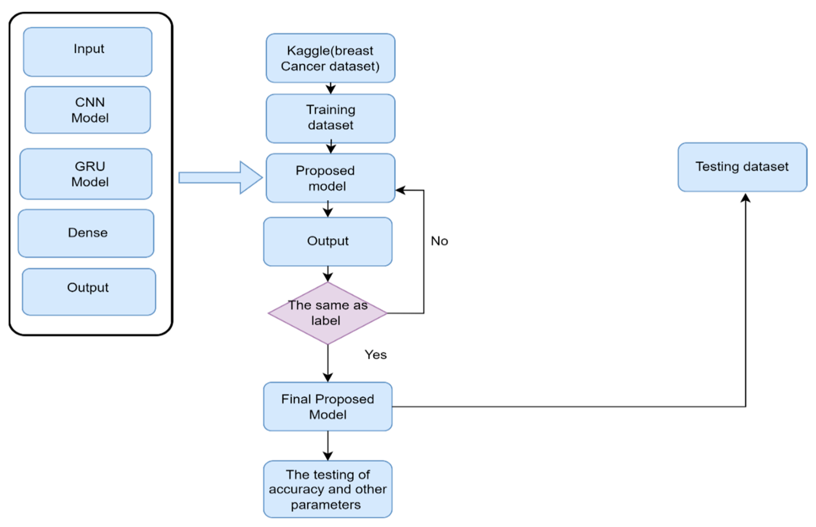
DESIGN & ANALYSIS
MODEL DIAGRAM

Slide 9
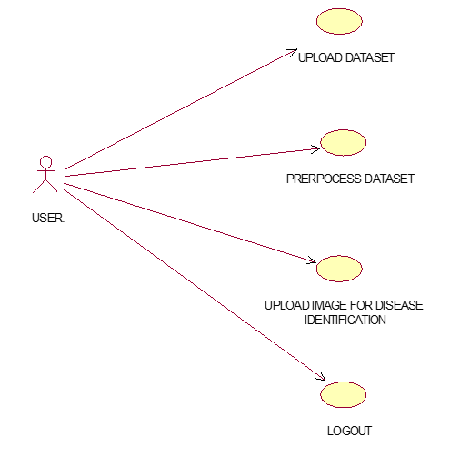
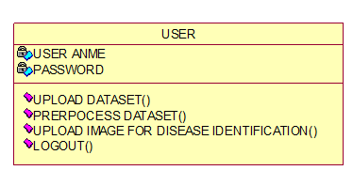
DESIGN & ANALYSIS
CLASS DIAGRAM:
USE CASE DIAGRAM:

Slide 10
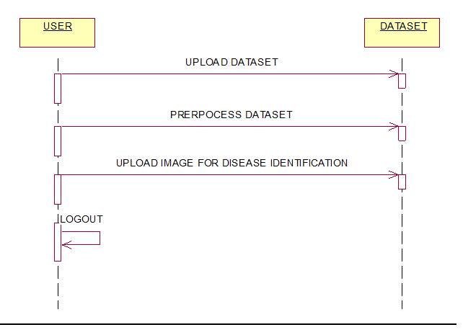
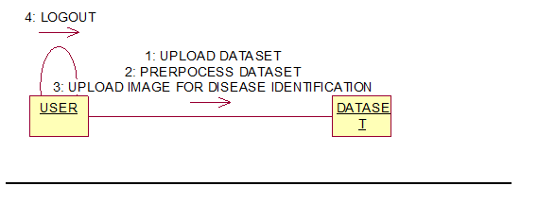
DESIGN & ANALYSIS
COLLRABATION DIAGRAM:
SEQUENCE DIAGRAM:

Slide 11
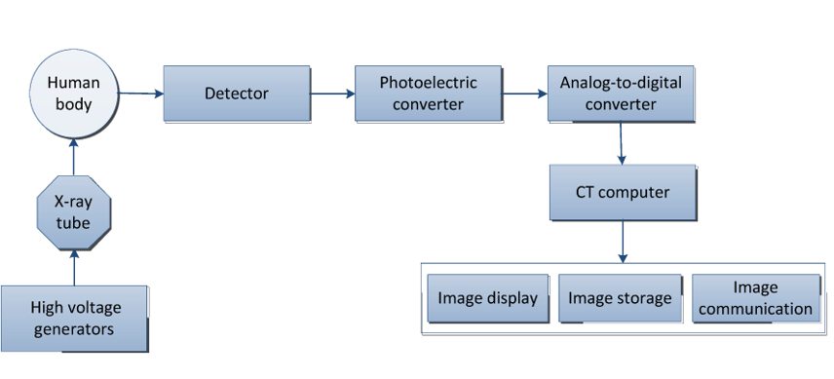
DESIGN & ANALYSIS
ACTIVITY DIAGRAM:

Slide 12

Thank You!!

